Slide 1

Automotive Technology: A Systems Approach, 8e
Chapter 51: Drum Brakes
Rob Thompson and Jack Erjavec, Automotive Technology: A Systems Approach, 8th Edition. © 2025 Cengage. All Rights Reserved. May not be scanned, copied or duplicated, or posted to a publicly accessible website, in whole or in part.

Slide 2
Chapter Objectives (1 of 2)
51.01 Explain how drum brakes operate.
51.02 Identify the major components of a typical drum brake and describe their functions.
51.03 Explain the difference between duo-servo and nonservo drum brakes.
51.04 Perform a cleaning and inspection of a drum brake assembly.

Slide 3
Chapter Objectives (2 of 2)
51.05 Recognize conditions that adversely affect the performance of drums, shoes, linings, and related hardware.
51.06 Remove and replace brake shoes and hardware.
51.07 Inspect and replace wheel cylinders.
51.08 Explain how typical drum parking brakes operate.

Slide 4
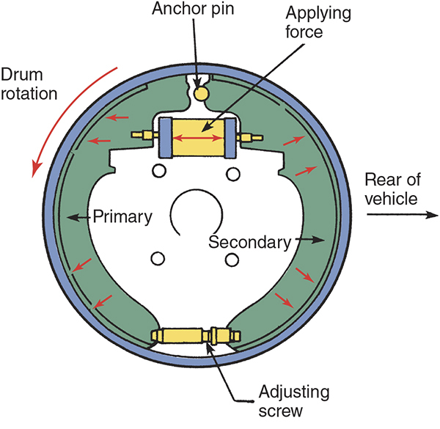
Drum Brake Operation (1 of 2)
51-01 Explain how drum brakes operate.
Hydraulic pressure in the wheel cylinder forces the shoes outward against the drum.

Slide 5

Drum Brake Operation (2 of 2)
Braking force is increased by the shoes attempting to rotate with the drum.
The anchor acts as a pivot to allow a wedging action between the shoes.

Slide 6
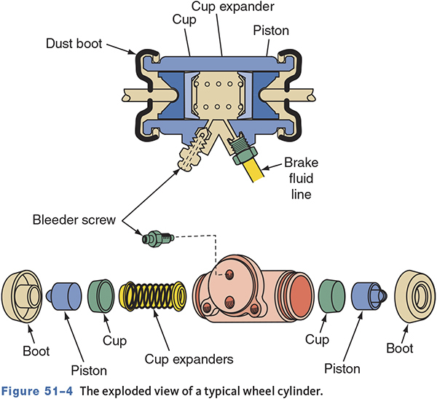
Wheel Cylinders
51-02 Identify the major components of a typical drum brake and describe their functions.
Convert hydraulic pressure to mechanical force

Slide 7
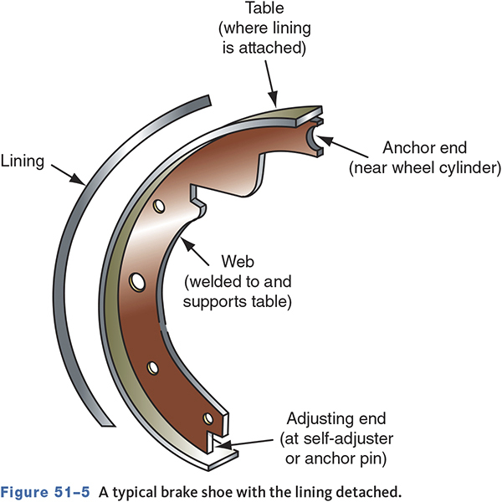
Brake Shoes and Linings
Linings can be bonded or riveted to the shoe.
Duo-servo shoes have a longer secondary shoe lining.
Leading-trailing shoes are typically identical.

Slide 8
Mechanical Components
Return Springs
    Return the shoe to the at-rest position
    May look the same but may not be interchangeable
Hold-Downs
    Secure the shoe to the backing plate
    May be used to attach other components

Slide 9
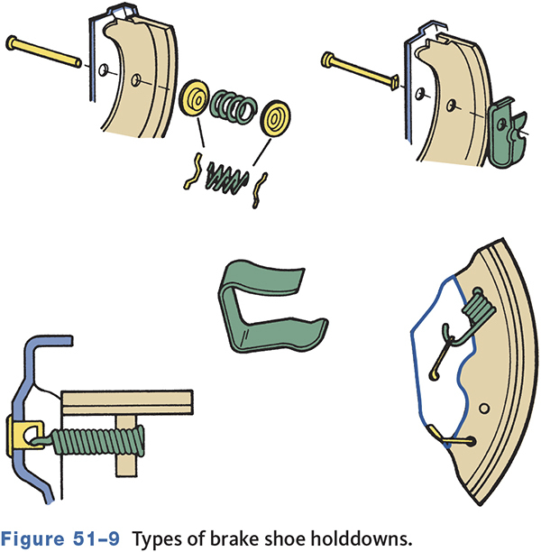
Holddowns

Slide 10
Shoe Anchors
Duo-servo brakes have the anchor at the top.
Nonservo brakes have the anchor at the bottom.
Other types
    Fixed nonadjustable
    Self-centering
    Adjustable

Slide 11
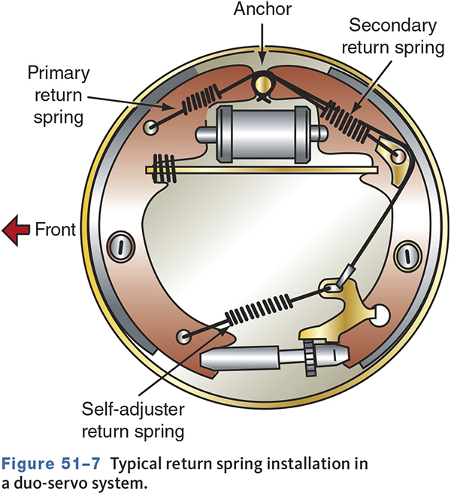
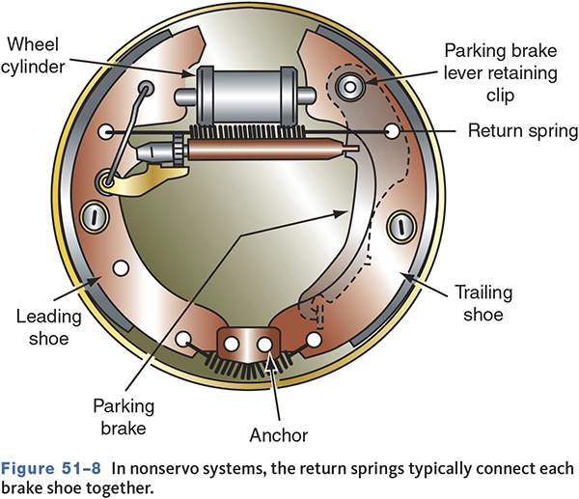
Anchors

Slide 12
Drums
Typically made of cast iron
    Some use an aluminum exterior and iron friction surface.
Drums do not dissipate heat well.
  one of the main reasons discs have replaced drums at the front of cars and light trucks, and at the rear of most cars.
May have integral bearing hub on FWD vehicles

Slide 13
Drum Brake Designs
51-03 Explain the difference between duo-servo and nonservo drum brakes.
Duo-servo
    Are self-energizing
    Are typically used on larger vehicles
Nonservo (leading-trailing)
    Have no self-energizing
    Are used on smaller vehicles

Slide 14
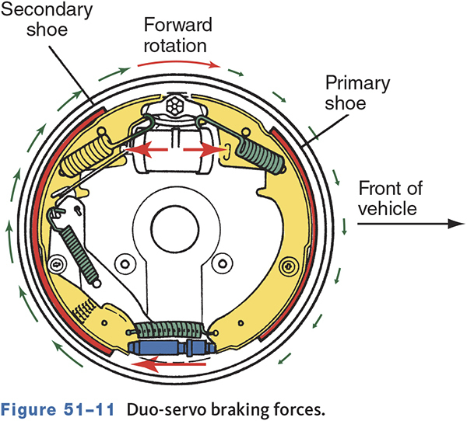
Duo-Servo Brakes

Slide 15
Knowledge Check (1 of 3)
Technician A says anchor location determines if a brake assembly is servo or nonservo. Technician B says wheel cylinder location determines if a brake assembly is servo or nonservo. Who is correct?

Slide 16
Knowledge Check Answer (1 of 3)
Technician A says anchor location determines if a brake assembly is servo or non-servo. Technician B says wheel cylinder location determines if a brake assembly is servo or non-servo. Who is correct?
Answer: Technician A Only

Slide 17
Types of Automatically Adjusted Servo Brakes
Cable operated
Cable with overtravel spring
Lever with override
Lever and pawl

Slide 18
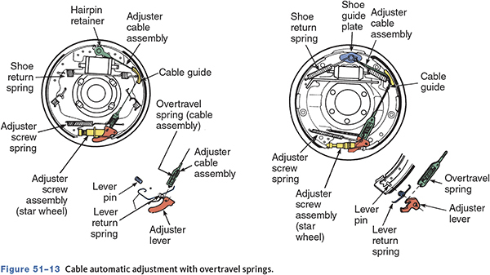
Cable with Overtravel Spring

Slide 19
Nonservo Drum Brakes
Also called leading-trailing shoe brakes
Typically used on smaller vehicles
Anchor prevents shoe rotation and self-energization.
Leading shoe does most of the braking.
Trailing shoe does most of the braking when moving in reverse.

Slide 20
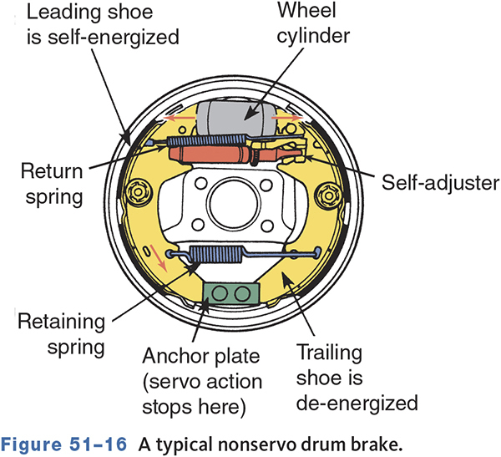
Typical Nonservo Brake

Slide 21
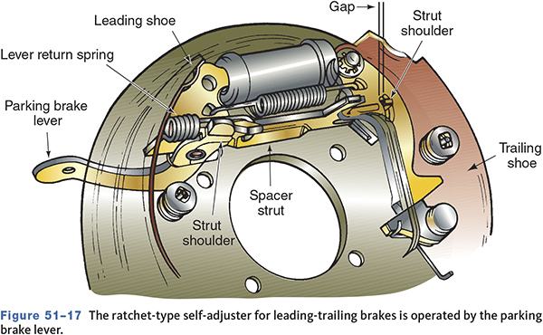
Ratchet Adjuster

Slide 22
Inspection and Service
Brake Noise
  Number one customer complaint
  Usually the first indication of wear or problems
  Also check bearings and suspension parts
  Grinding can be from worn linings or foreign objects lodged between the shoe and drum.
  Rattles and clicks can indicate failed hardware.

Slide 23
Road Testing Brakes
Road test whenever practical
Check pedal reserve and fluid level first
Drive on dry, clean, and smooth roads
Test brake operation at different speeds and with light and heavy pedal pressure
Be aware of other problems that can present as brake problems

Slide 24
Drum Brake Inspection
51-04 Perform a cleaning and inspection of a drum brake assembly.
Shoe adjustment may need backed off first.
Do not try to pry drum off.
Mark drum left or right for reinstallation.
Inspect hub and grease, if applicable.
Place drum aside with open face down on a bench.

Slide 25
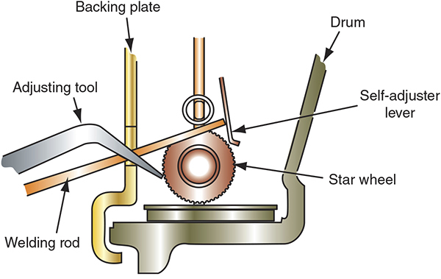
Drum Removal
Manually retract the self adjusters.
Use a drum puller to remove stuck drums.
Prying the drum off can damage the backing plate.

Slide 26
Asbestos Caution
Breathing dust-containing asbestos fibers can cause serious bodily harm.
Do not create dust by cleaning with a brush or compressed air
Clean dust away using an OSHA-approved brake washer or vacuum
If a dedicated brake washer is not available, spray the dust off using commercial brake cleaner.

Slide 27
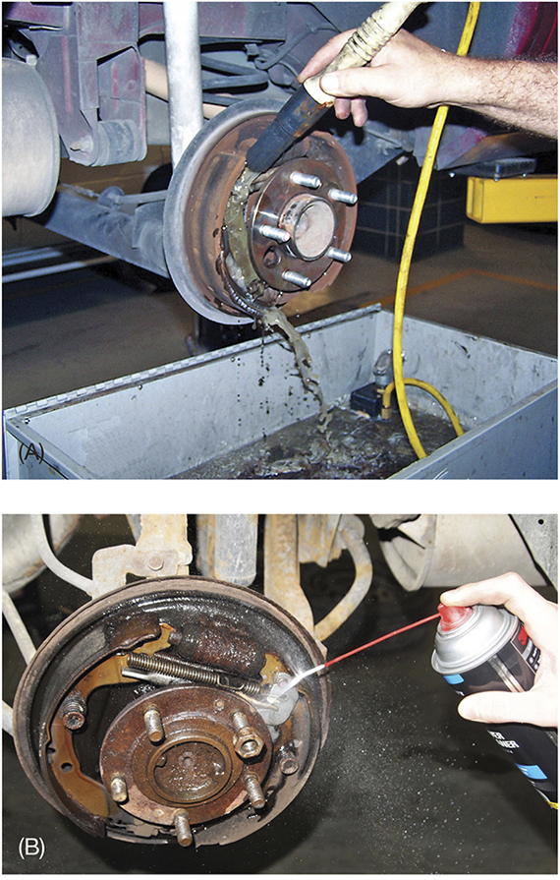
Asbestos Removal

Slide 28
Knowledge Check (2 of 3)
Why must drum brake dust be properly captured and cleaned?

Slide 29
Knowledge Check Answer (2 of 3)
Why must drum brake dust be properly captured and cleaned?
Answer: To prevent brake dust, which may contain asbestos, from becoming airborne and being inhaled.

Slide 30
Drum Inspection
Thoroughly clean the drum
As drums wear, their cooling surface and structural strength is reduced and their operating temperature increases.
  This can lead to distortion.

Slide 31
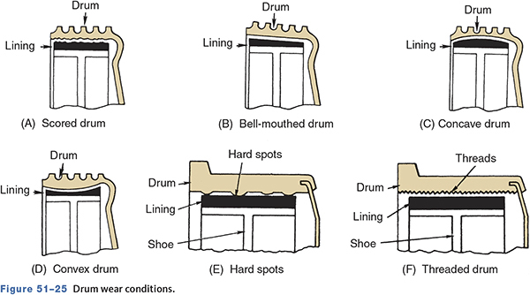
Common Drum Conditions
51-05 Recognize conditions that adversely affect the performance of drums, shoes, linings, and related hardware.

Slide 32
Drum Measurements
Measure every drum even if they visually look good.
Take measurements at right angles to check for out-of-round.
True and smooth drums may be polished with emery cloth.
Deep scores or grooves must be machined or the drum replaced.

Slide 33
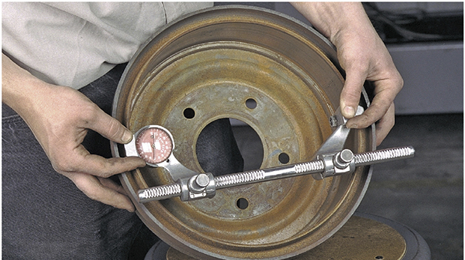
Drum Micrometer

Slide 34
Drum Refinishing
Remove only enough to obtain a true, smooth friction surface
If one drum needs to be refinished, the other drum must also be machined the same.
Drums are stamped with their maximum allowable machining dimension.
There must be 0.030” (0.762 mm) left for wear after machining the drum.

Slide 35
Cleaning Newly Refaced Drums
A refinished drum’s friction surface contains tiny metal particles.
This metal dust must be removed so as not to contaminate the new linings.
Clean with soap and water
Dry thoroughly

Slide 36
Brake Shoe and Lining inspection
Inspect for uneven wear, imbedded foreign material, loose rivets, and fluid contamination
  Lining materials influence braking
  Friction Material
    Too high of a coefficient of friction (COF) can result in grabbing.
    Too low of a COF can result in overheating, glazing, a hard pedal, and brake fade.

Slide 37
Selecting Replacement Linings
51-06 Remove and replace brake shoes and hardware.
Automotive friction material codes are printed on the edges of brake linings.
Identify the manufacturer, lining material, and the cold and hot coefficients of friction.
  Soft linings have higher a COF but wear faster, are less abrasive on the drum, and are quieter than hard linings.

Slide 38
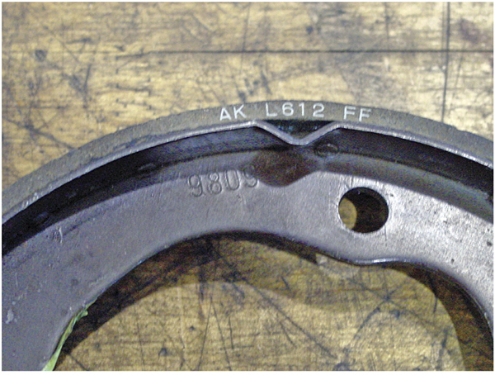
Identification Codes

Slide 39
Cleaning and Inspecting Brake Parts
Wet clean backing plates and other parts
Examine raised shoe pads for wear
Check for cracks or bending of backing plate
Disassemble, clean, and lubricate the self-adjuster mechanism
Lube the backing plate pads
Use manufacturer-specified lubricants only.

Slide 40
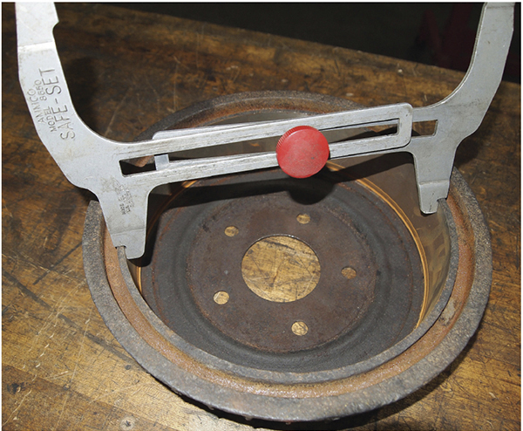
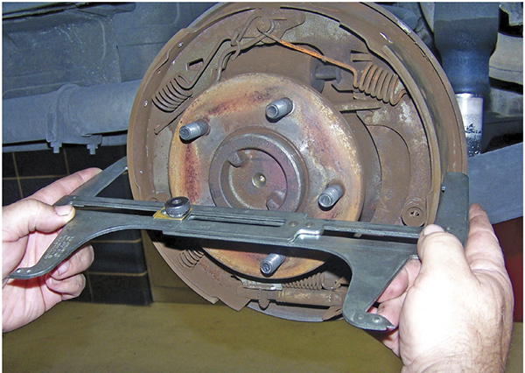
Lining Adjustment
Adjust shoes to the point of drag against the drum but not dragging heavily
A shoe-to-drum gauge makes pre-adjusting easier.

Slide 41
Wheel Cylinder
Inspection and Service
51-07 Inspect and replace wheel cylinders.
Inspect for leaks and under the dust boot
    A slight dampening is normal, a dripping is not.
Cylinder binding can be caused by rust deposits.
Cylinders may be rebuilt or replaced.
Some can be rebuilt on vehicle.

Slide 42
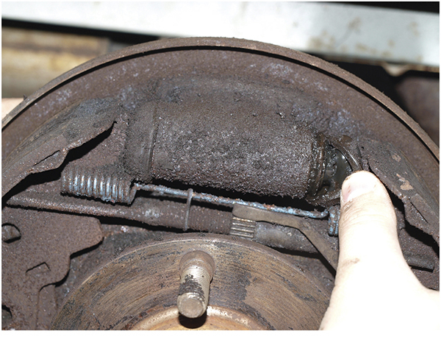
Wheel Cylinder Inspection

Slide 43
Drum Parking Brakes
51-08 Explain how typical drum parking brakes operate.
Are not part of the hydraulic system
May be hand or foot operated
Some vehicles have a vacuum-operated release.
Some newer vehicles use electric parking brake activation.

Slide 44
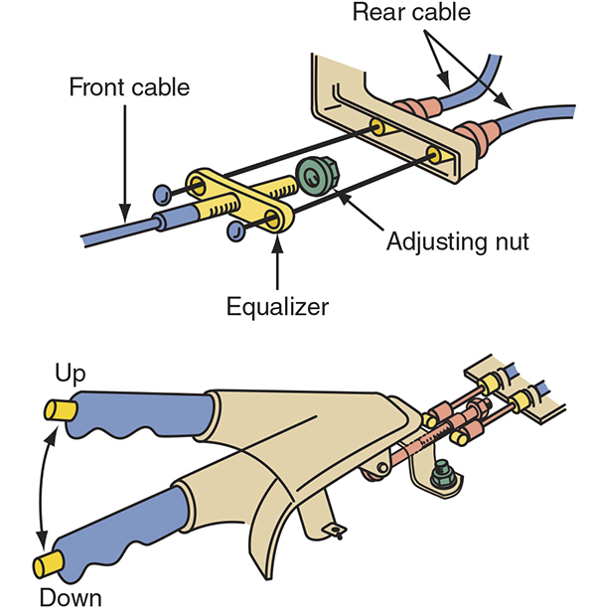
Hand-Operated Parking Brake

Slide 45
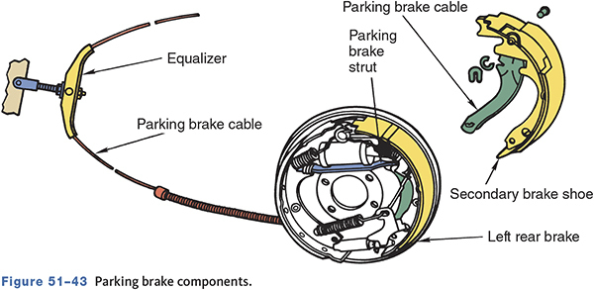
Parking Brake Components

Slide 46
Adjusting and Replacing Parking Brakes
Service the drum brakes before servicing the parking brake
Check for seized, sticking, or frayed cables
Most manufacturers specify a certain number of application “clicks” to fully set the parking brake.

Slide 47
Knowledge Check (3 of 3)
After replacing brake shoes, the brake pedal is low and the parking brake does not hold. Technician A says the shoe-to-drum clearance is likely excessive. Technician B says the parking brake cable needs to be adjusted. Who is correct?

Slide 48
Knowledge Check Answer (3 of 3)
After replacing brake shoes, the brake pedal is low and the parking brake does not hold. Technician A says the shoe-to-drum clearance is likely excessive. Technician B says the parking brake cable needs to be adjusted. Who is correct?
Answer: Technician A Only

Slide 49
Chapter Reflection
What concept from this chapter challenged you the most? Describe what made the concept difficult for you and the steps you took to improve your understanding.
How could you help another learner who was struggling with the same concept?
Use 100–150 words in your answer.

